Slide 1

21CSC202J OPERATING SYSTEMS UNIT – V
Course Learning Rationale (CLR):
CLR-4: Identify and tell the various embedded operating systems and computer security concepts.
CLR-5: Name the various computer security techniques in windows and Linux
Course Learning Outcomes (CLO):
CLO-5 :Demonstrate different device and resource management techniques for memory utilization with security mechanisms

Slide 2
Topics covered
Goals of Protection
Principles of Protection
Protection Rings
Domain of Protection
Access Matrix
Implementation of Access Matrix
Revocation of Access Rights
Role-based Access Control
Mandatory Access Control (MAC)
Capability-Based Systems
Other Protection Implementation Methods
Language-based Protection

Slide 3
Objectives
Discuss the goals and principles of protection in a modern computer system
Explain how protection domains combined with an access matrix are used to specify the resources a process may access
Examine capability and language-based protection systems
Describe how protection mechanisms can mitigate system attacks

Slide 4
Goals of Protection
In one protection model, computer consists of a collection of objects, hardware or software
Each object has a unique name and can be accessed through a well-defined set of operations
Protection problem - ensure that each object is accessed correctly and only by those processes that are allowed to do so

Slide 5
Principles of Protection
Guiding principle – principle of least privilege
Programs, users and systems should be given just enough privileges to perform their tasks
Properly set permissions can limit damage if entity has a bug, gets abused
Can be static (during life of system, during life of process)
Or dynamic (changed by process as needed) – domain switching, privilege escalation
Compartmentalization a derivative concept regarding access to data
Process of protecting each individual system component through the use of specific permissions and access restrictions

Slide 6
Principles of Protection (Cont.)
Must consider “grain” aspect
Rough-grained privilege management easier, simpler, but least privilege now done in large chunks
For example, traditional Unix processes either have abilities of the associated user, or of root
Fine-grained management more complex, more overhead, but more protective
File ACL lists, RBAC
Domain can be user, process, procedure
Audit trail – recording all protection-orientated activities, important to understanding what happened, why, and catching things that shouldn’t
No single principle is a panacea for security vulnerabilities – need defense in depth

Slide 7
Protection Rings
Components ordered by amount of privilege and protected from each other
For example, the kernel is in one ring and user applications in another
This privilege separation requires hardware support
Gates used to transfer between levels, for example the syscall Intel instruction
Also traps and interrupts
Hypervisors introduced the need for yet another ring
ARMv7 processors added TrustZone(TZ) ring to protect crypto functions with access via new Secure Monitor Call (SMC) instruction
Protecting NFC secure element and crypto keys from even the kernel

Slide 8
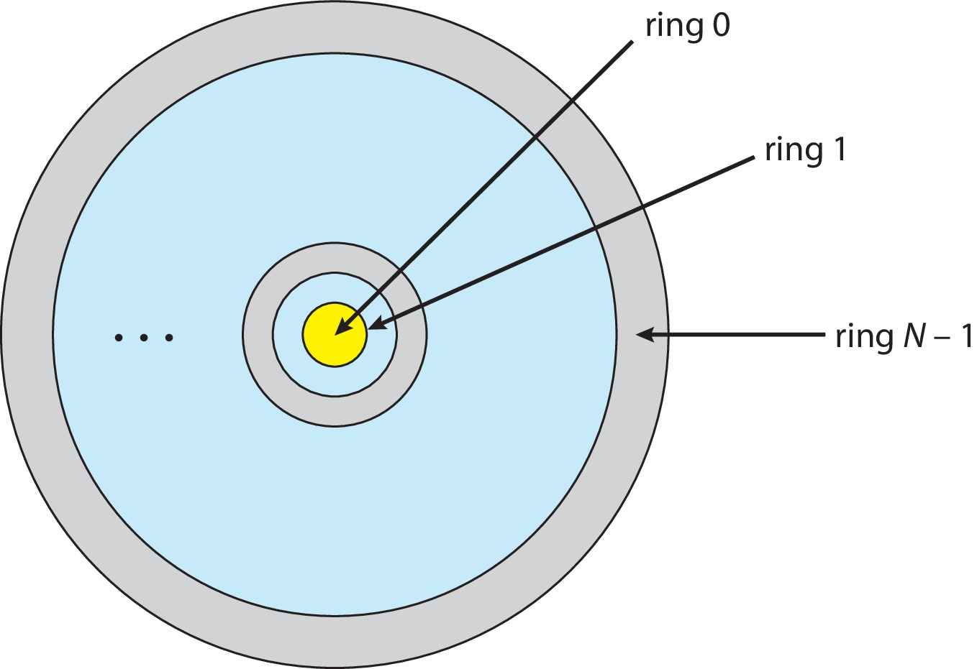
Protection Rings (MULTICS)
Let D_{i} and D_{j} be any two domain rings
If j < I ⇒ D_{i} ⊆ D_{j}

Slide 9
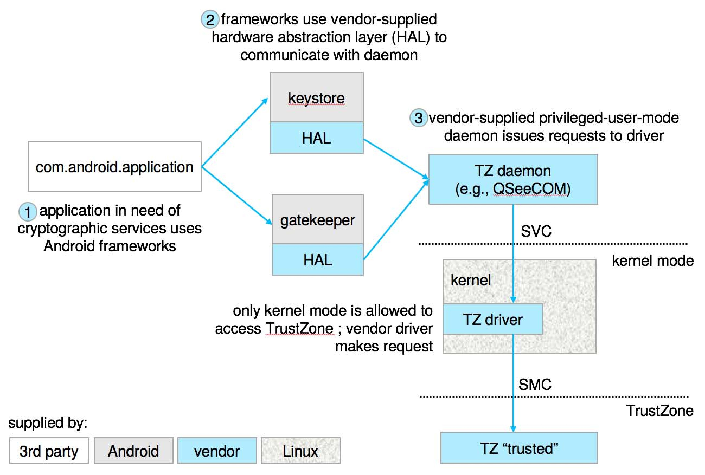
Android use of TrustZone

Slide 10
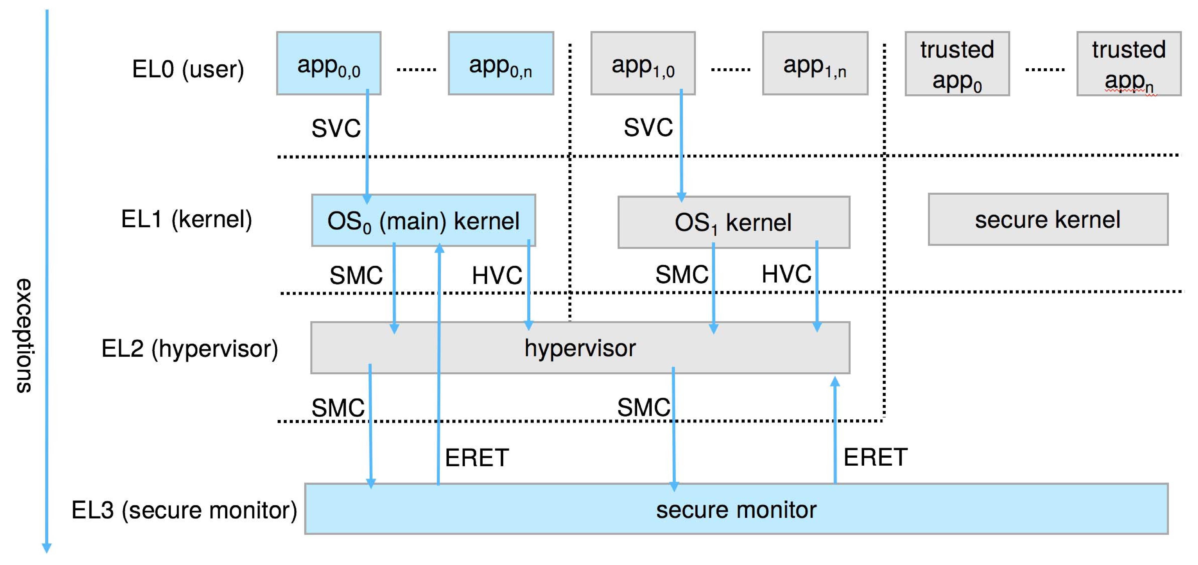
ARM CPU Architecture

Slide 11
Domain of Protection
Rings of protection separate functions into domains and order them hierarchically
Computer can be treated as processes and objects
Hardware objects (such as devices) and software objects (such as files, programs, semaphores
Process for example should only have access to objects it currently requires to complete its task – the need-to-know principle

Slide 12
Domain of Protection (Cont.)
Implementation can be via process operating in a protection domain
Specifies resources process may access
Each domain specifies set of objects and types of operations on them
Ability to execute an operation on an object is an access right
<object-name, rights-set>
Domains may share access rights
Associations can be static or dynamic
If dynamic, processes can domain switch

Slide 13
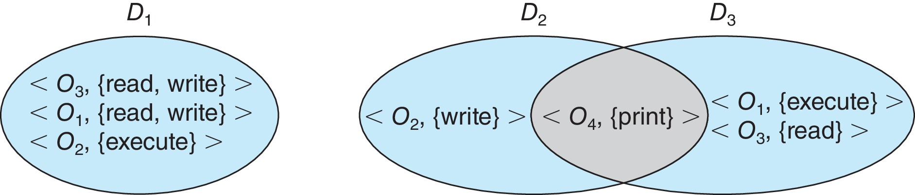
Domain Structure
Access-right = <object-name, rights-set> where rights-set is a subset of all valid operations that can be performed on the object
Domain = set of access-rights

Slide 14
Domain Implementation (UNIX)
Domain = user-id
Domain switch accomplished via file system
Each file has associated with it a domain bit (setuid bit)
When file is executed and setuid = on, then user-id is set to owner of the file being executed
When execution completes user-id is reset
Domain switch accomplished via passwords
su command temporarily switches to another user’s domain when other domain’s password provided
Domain switching via commands
sudo command prefix executes specified command in another domain (if original domain has privilege or password given)

Slide 15
Domain Implementation (Android App IDs)
In Android, distinct user IDs are provided on a per-application basis
When an application is installed, the installd daemon assigns it a distinct user ID (UID) and group ID (GID), along with a private data directory (/data/data/<appname>) whose ownership is granted to this UID/GID combination alone.
Applications on the device enjoy the same level of protection provided by UNIX systems to separate users
A quick and simple way to provide isolation, security, and privacy.
The mechanism is extended by modifying the kernel to allow certain operations (such as networking sockets) only to members of a particular GID (for example, AID INET, 3003)
A further enhancement by Android is to define certain UIDs as “isolated,” prevents them from initiating RPC requests to any but a bare minimum of services

Slide 16
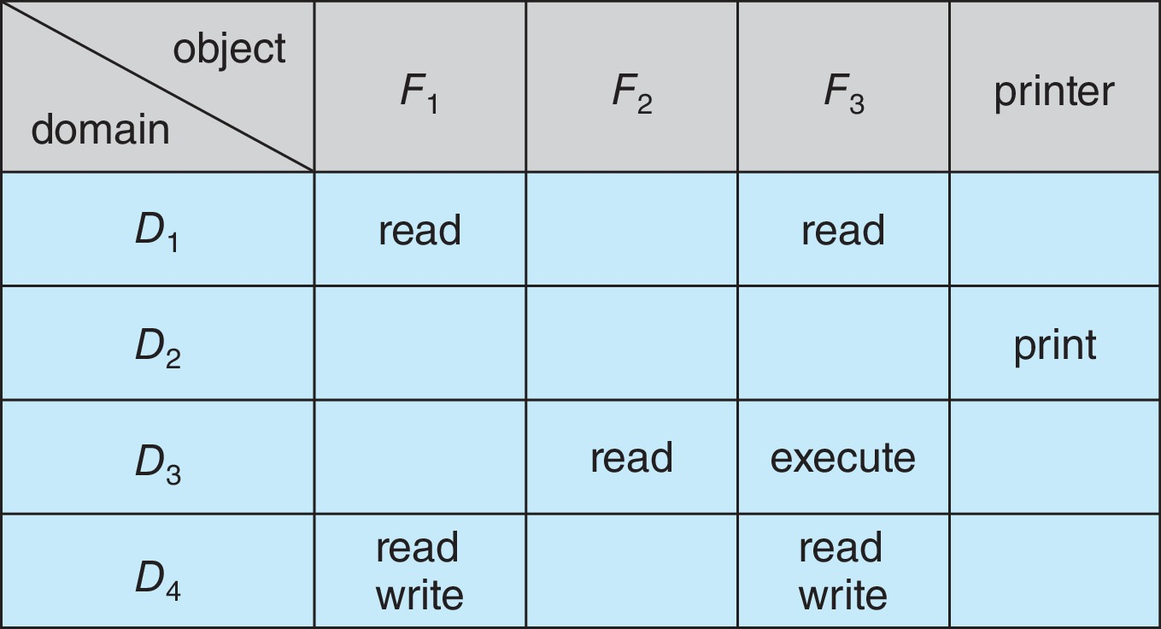
Access Matrix
View protection as a matrix (access matrix)
Rows represent domains
Columns represent objects
Access(i, j) is the set of operations that a process executing in Domain_{i} can invoke on Object_{j}

Slide 17
Use of Access Matrix
If a process in Domain D_{i} tries to do “op” on object O_{j}, then “op” must be in the access matrix
User who creates object can define access column for that object
Can be expanded to dynamic protection
Operations to add, delete access rights
Special access rights:
owner of O_{i}
copy op from O_{i} to O_{j} (denoted by “*”)
control – D_{i} can modify D_{j} access rights
transfer – switch from domain D_{i} to D_{j}
Copy and Owner applicable to an object
Control applicable to domain object

Slide 18
Use of Access Matrix (Cont.)
Access matrix design separates mechanism from policy
Mechanism
Operating system provides access-matrix + rules
If ensures that the matrix is only manipulated by authorized agents and that rules are strictly enforced
Policy
User dictates policy
Who can access what object and in what mode
But doesn’t solve the general confinement problem

Slide 19
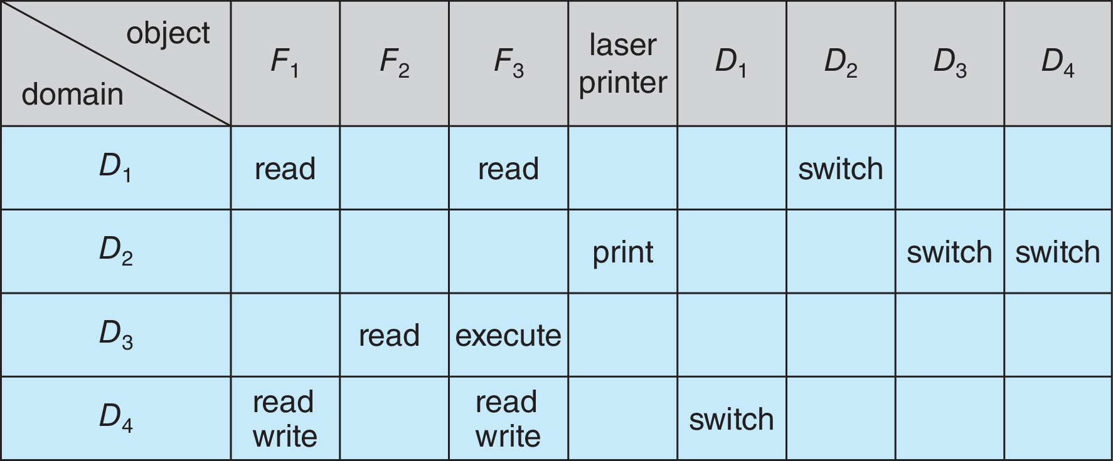
Access Matrix of Figure A with Domains as Objects

Slide 20
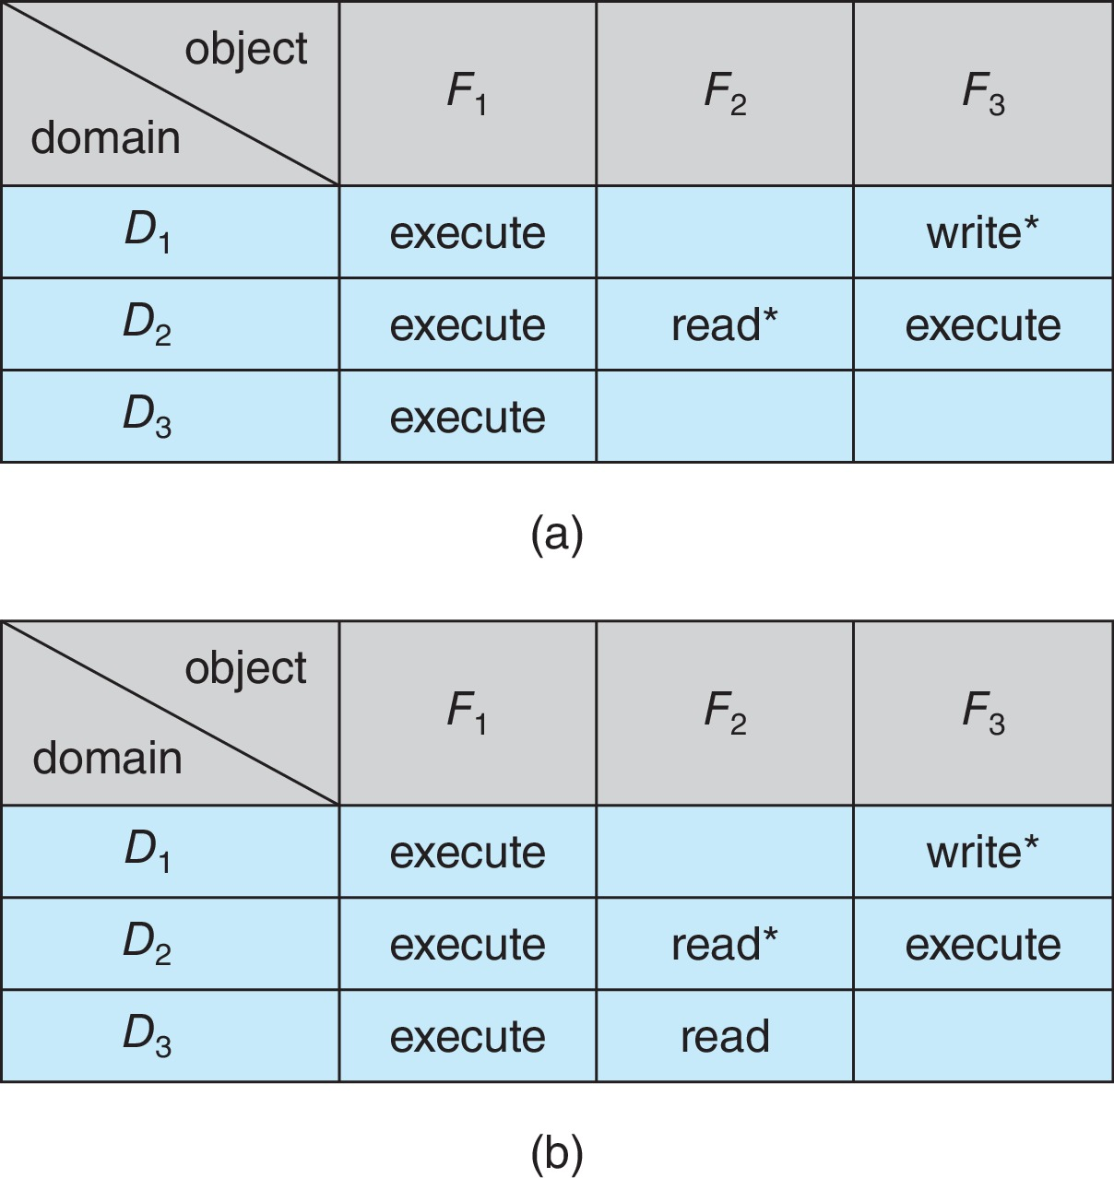
Access Matrix with Copy Rights

Slide 21
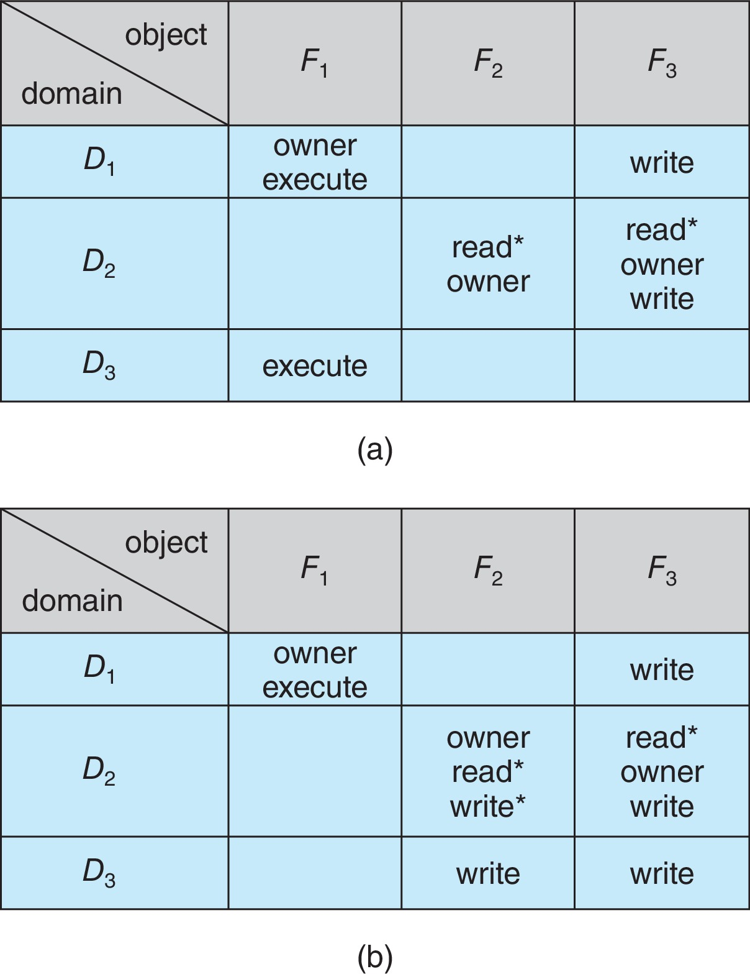
Access Matrix With Owner Rights

Slide 22
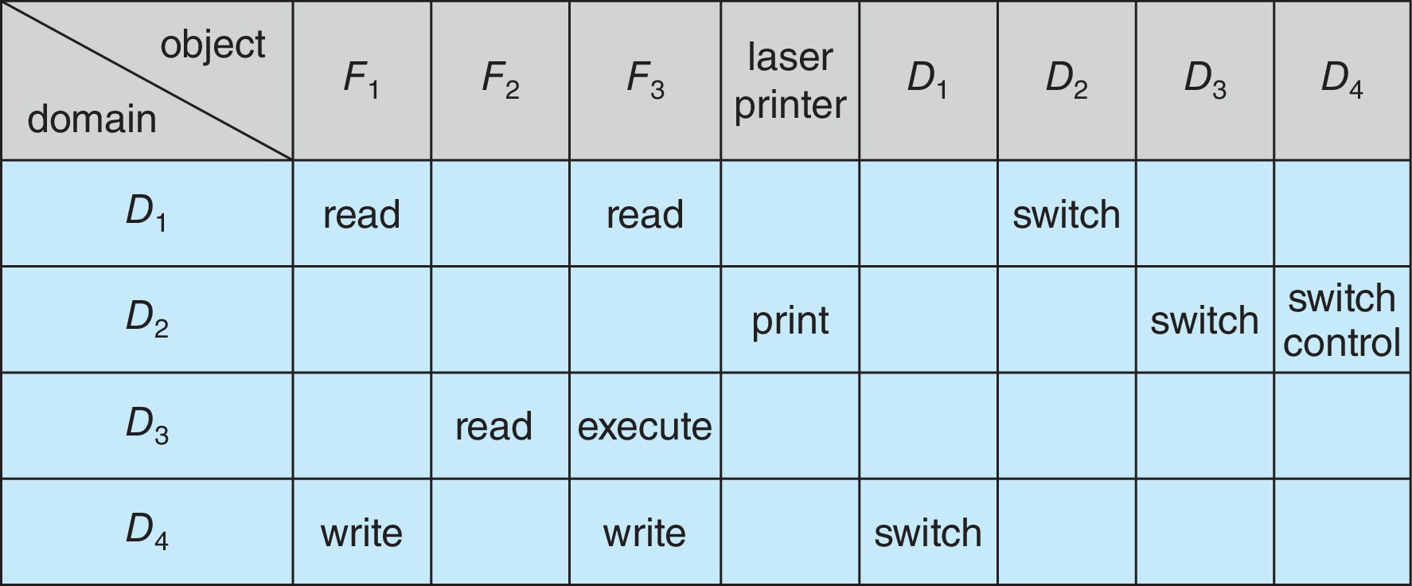
Modified Access Matrix of Figure B

Slide 23
Implementation of Access Matrix
Generally, a sparse matrix
Option 1 – Global table
Store ordered triples <domain, object, rights-set> in table
A requested operation M on object O_{j} within domain D_{i} -> search table for < D_{i}, O_{j}, R_{k} >
with M ∈ R_{k}
But table could be large -> won’t fit in main memory
Difficult to group objects (consider an object that all domains can read)

Slide 24
Implementation of Access Matrix
Option 2 – Access lists for objects
Each column implemented as an access list for one object
Resulting per-object list consists of ordered pairs <domain, rights-set> defining all domains with non-empty set of access rights for the object
Easily extended to contain default set -> If M ∈ default set, also allow access

Slide 25
Implementation of Access Matrix
Each column = Access-control list for one object Defines who can perform what operation Domain 1 = Read, Write Domain 2 = Read Domain 3 = Read
Each Row = Capability List (like a key) For each domain, what operations allowed on what objects
Object F1 – Read
Object F4 – Read, Write, Execute
Object F5 – Read, Write, Delete, Copy

Slide 26
Implementation of Access Matrix
Option 3 – Capability list for domains
Instead of object-based, list is domain based
Capability list for domain is list of objects together with operations allows on them
Object represented by its name or address, called a capability
Execute operation M on object O_{j}, process requests operation and specifies capability as parameter
Possession of capability means access is allowed
Capability list associated with domain but never directly accessible by domain
Rather, protected object, maintained by OS and accessed indirectly
Like a “secure pointer”
Idea can be extended up to applications

Slide 27
Implementation of Access Matrix
Option 4 – Lock-key
Compromise between access lists and capability lists
Each object has list of unique bit patterns, called locks
Each domain as list of unique bit patterns called keys
Process in a domain can only access object if domain has key that matches one of the locks

Slide 28
Comparison of Implementations
Many trade-offs to consider
Global table is simple, but can be large
Access lists correspond to needs of users
Determining set of access rights for domain non-localized so difficult
Every access to an object must be checked
Many objects and access rights -> slow
Capability lists useful for localizing information for a given process
But revocation capabilities can be inefficient
Lock-key effective and flexible, keys can be passed freely from domain to domain, easy revocation

Slide 29
Comparison of Implementations
Most systems use combination of access lists and capabilities
First access to an object -> access list searched
If allowed, capability created and attached to process
Additional accesses need not be checked
After last access, capability destroyed
Consider file system with ACLs per file

Slide 30
Revocation of Access Rights
Various options to remove the access right of a domain to an object
Immediate vs. delayed
Selective vs. general
Partial vs. total
Temporary vs. permanent
Access List – Delete access rights from access list
Simple – search access list and remove entry
Immediate, general or selective, total or partial, permanent or temporary

Slide 31
Revocation of Access Rights
Capability List – Scheme required to locate capability in the system before capability can be revoked
Reacquisition – periodic delete, with require and denial if revoked
Back-pointers – set of pointers from each object to all capabilities of that object (Multics)
Indirection – capability points to global table entry which points to object – delete entry from global table, not selective (CAL)
Keys – unique bits associated with capability, generated when capability created
Master key associated with object, key matches master key for access
Revocation – create new master key
Policy decision of who can create and modify keys – object owner or others?

Slide 32
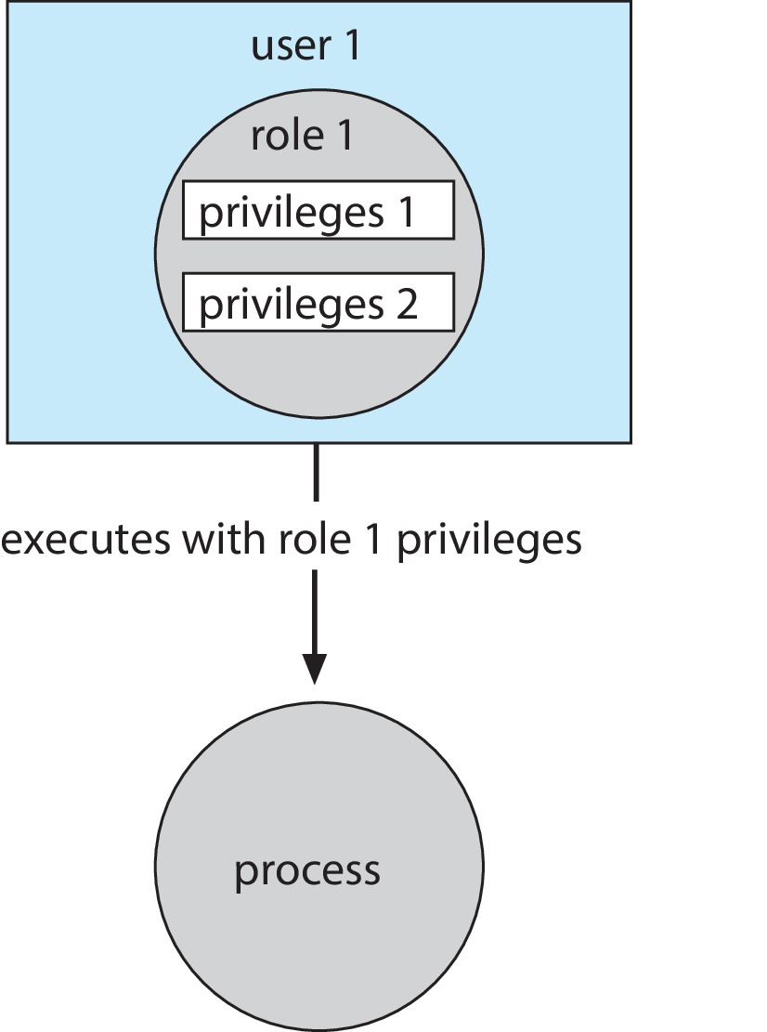
Role-based Access Control
Protection can be applied to non-file resources
Oracle Solaris 10 provides role-based access control (RBAC) to implement least privilege
Privilege is right to execute system call or use an option within a system call
Can be assigned to processes
Users assigned roles granting access to privileges and programs
Enable role via password to gain its privileges
Similar to access matrix

Slide 33
Mandatory Access Control (MAC)
Operating systems traditionally had discretionary access control (DAC) to limit access to files and other objects (for example UNIX file permissions and Windows access control lists (ACLs))
Discretionary is a weakness – users / admins need to do something to increase protection
Stronger form is mandatory access control, which even root user can’t circumvent
Makes resources inaccessible except to their intended owners
Modern systems implement both MAC and DAC, with MAC usually a more secure, optional configuration (Trusted Solaris, TrustedBSD (used in macOS), SELinux), Windows Vista MAC)
At its heart, labels assigned to objects and subjects (including processes)
When a subject requests access to an object, policy checked to determine whether or not a given label-holding subject is allowed to perform the action on the object

Slide 34
Capability-Based Systems
Hydra and CAP were first capability-based systems
Now included in Linux, Android and others, based on POSIX.1e (that never became a standard)
Essentially slices up root powers into distinct areas, each represented by a bitmap bit
Fine grain control over privileged operations can be achieved by setting or masking the bitmap
Three sets of bitmaps – permitted, effective, and inheritable
Can apply per process or per thread
Once revoked, cannot be reacquired
Process or thread starts with all privs, voluntarily decreases set during execution
Essentially a direct implementation of the principle of least privilege
An improvement over root having all privileges but inflexible (adding new privilege difficult, etc.)

Slide 35
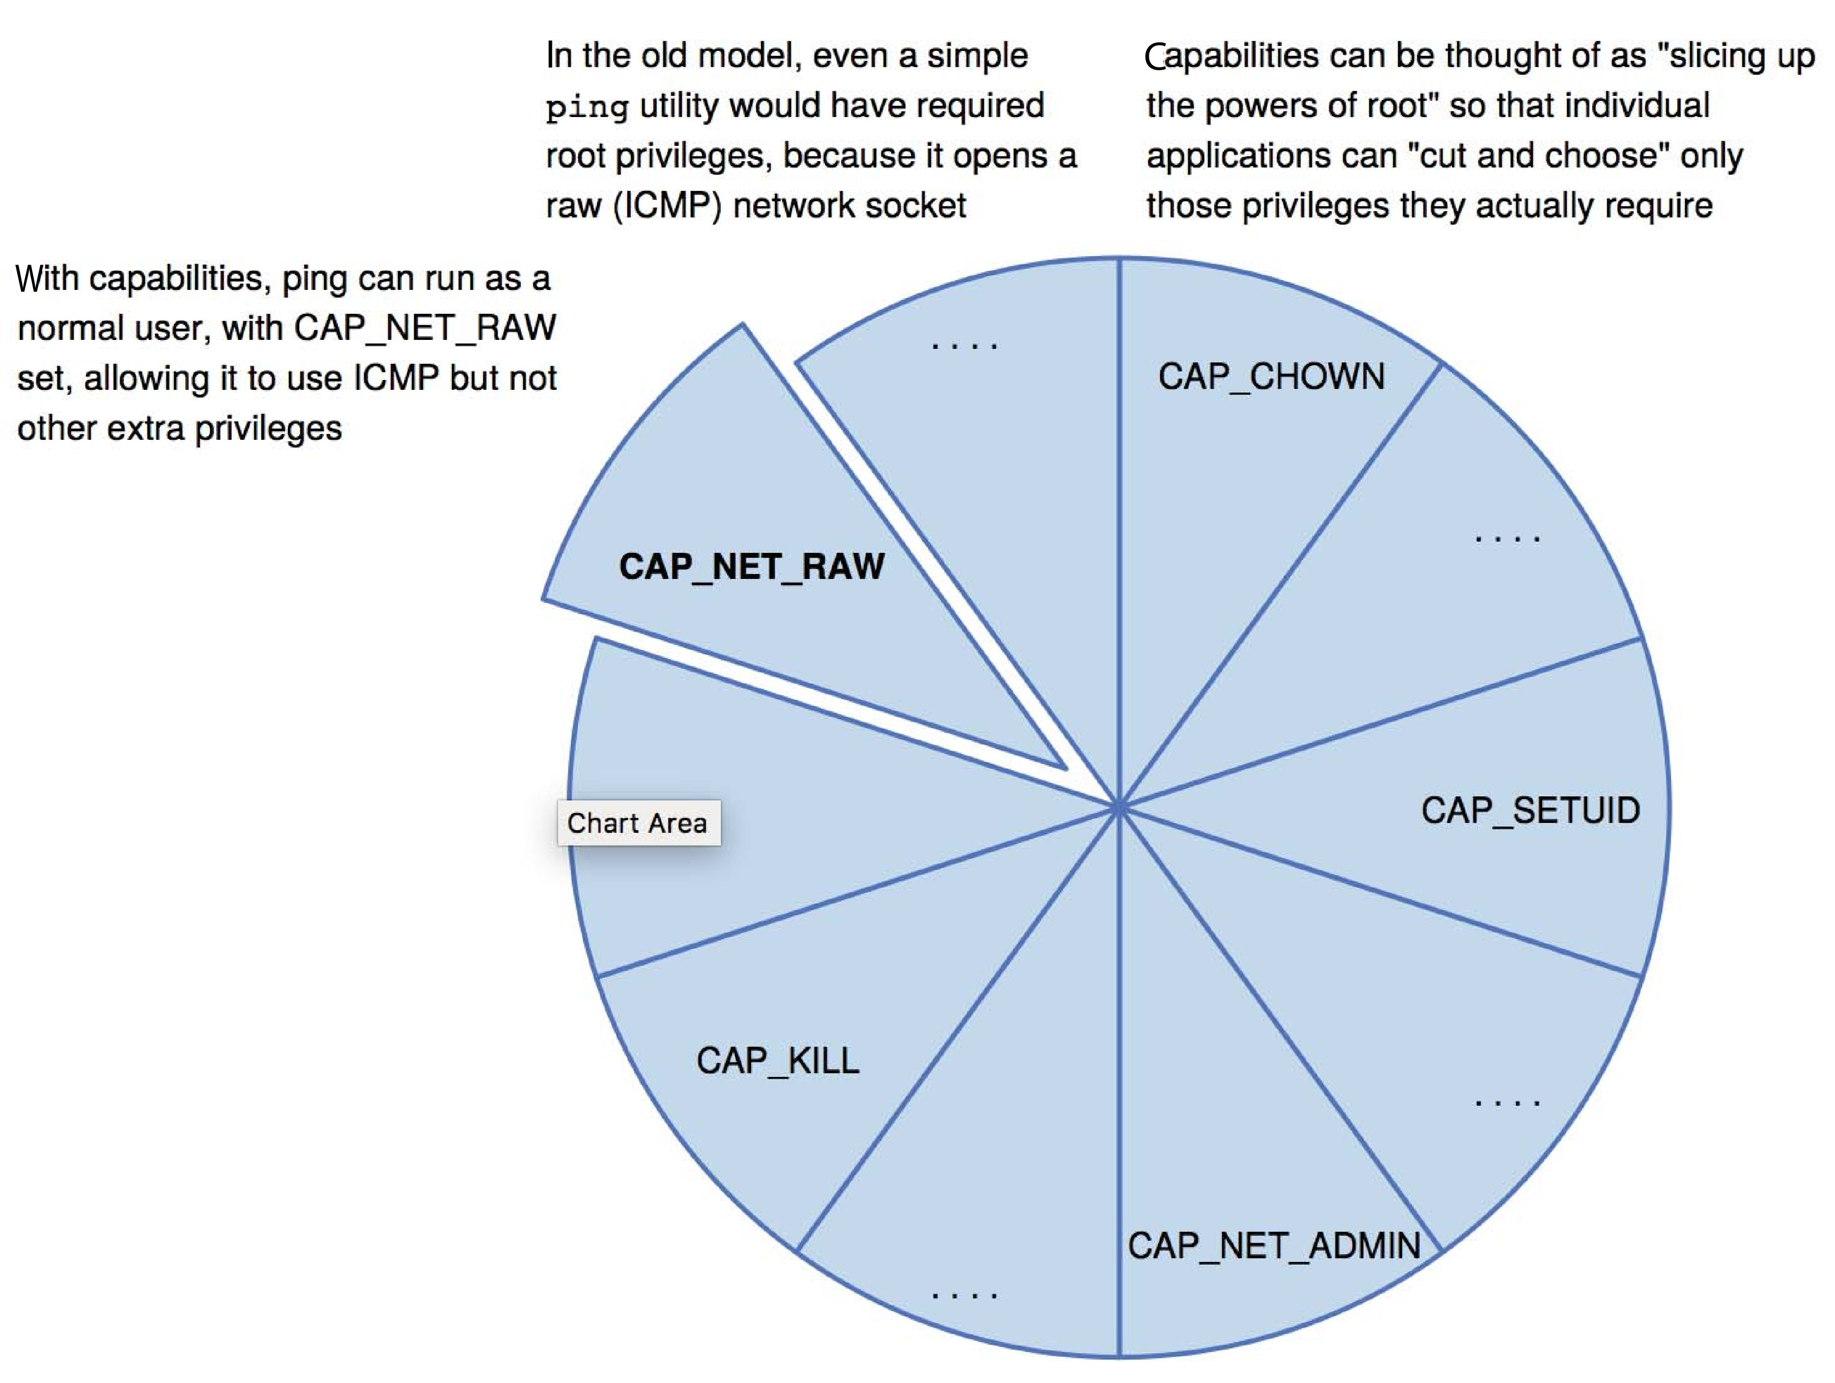
Capabilities in POSIX.1e

Slide 36
Other Protection Improvement Methods
System integrity protection (SIP)
Introduced by Apple in macOS 10.11
Restricts access to system files and resources, even by root
Uses extended file attribs to mark a binary to restrict changes, disable debugging and scrutinizing
Also, only code-signed kernel extensions allowed and configurably only code-signed apps
System-call filtering
Like a firewall, for system calls
Can also be deeper –inspecting all system call arguments
Linux implements via SECCOMP-BPF (Berkeley packet filtering)

Slide 37
Other Protection Improvement Methods (Cont.)
Sandboxing
Running process in limited environment
Impose set of irremovable restrictions early in startup of process (before main())
Process then unable to access any resources beyond its allowed set
Java and .net implement at a virtual machine level
Other systems use MAC to implement
Apple was an early adopter, from macOS 10.5’s “seatbelt” feature
Dynamic profiles written in the Scheme language, managing system calls even at the argument level
Apple now does SIP, a system-wide platform profile

Slide 38
Other Protection Improvement Methods (Cont.)
Code signing allows a system to trust a program or script by using crypto hash to have the developer sign the executable
So code as it was compiled by the author
If the code is changed, signature invalid and (some) systems disable execution
Can also be used to disable old programs by the operating system vendor (such as Apple) cosigning apps, and then invaliding those signatures so the code will no longer run

Slide 39
Language-Based Protection
Specification of protection in a programming language allows the high-level description of policies for the allocation and use of resources
Language implementation can provide software for protection enforcement when automatic hardware-supported checking is unavailable
Interpret protection specifications to generate calls on whatever protection system is provided by the hardware and the operating system

Slide 40
Protection in Java 2
Protection is handled by the Java Virtual Machine (JVM)
A class is assigned a protection domain when it is loaded by the JVM
The protection domain indicates what operations the class can (and cannot) perform
If a library method is invoked that performs a privileged operation, the stack is inspected to ensure the operation can be performed by the library
Generally, Java’s load-time and run-time checks enforce type safety
Classes effectively encapsulate and protect data and methods from other classes

Slide 41
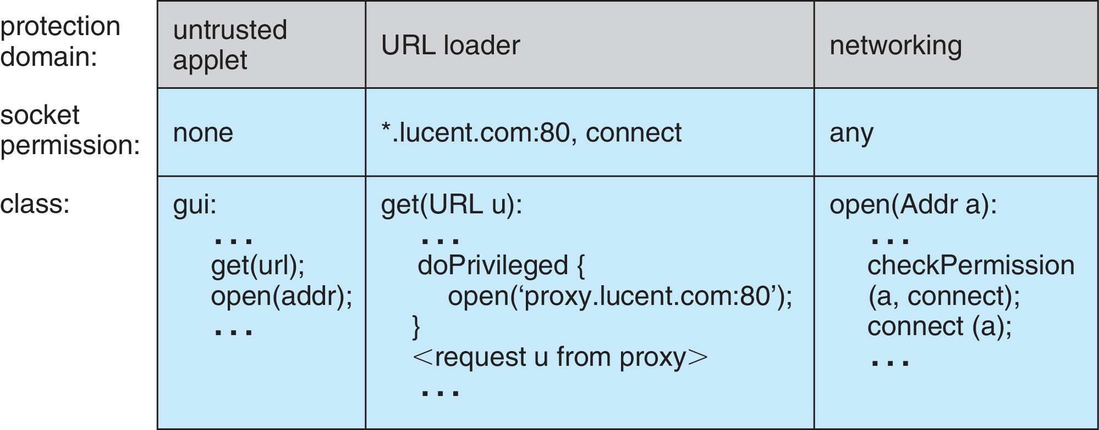
Stack Inspection

Slide 42
Topics Covered under Security
The Security Problem
Program Threats
System and Network Threats
Cryptography as a Security Tool
User Authentication
Implementing Security Defenses
Firewalling to Protect Systems and Networks
Computer-Security Classifications
An Example: Windows 7

Slide 43
Objectives
Discuss security threats and attacks
Explain the fundamentals of encryption, authentication, and hashing
Examine the uses of cryptography in computing
Describe the various countermeasures to security attacks

Slide 44
The Security Problem
System secure if resources used and accessed as intended under all circumstances
Unachievable
Intruders (crackers) attempt to breach security
Threat is potential security violation
Attack is attempt to breach security
Attack can be accidental or malicious
Easier to protect against accidental than malicious misuse

Slide 45
Security Violation Categories
Breach of confidentiality
Unauthorized reading of data
Breach of integrity
Unauthorized modification of data
Breach of availability
Unauthorized destruction of data
Theft of service
Unauthorized use of resources
Denial of service (DOS)
Prevention of legitimate use

Slide 46
Security Violation Methods
Masquerading (breach authentication)
Pretending to be an authorized user to escalate privileges
Replay attack
As is or with message modification
Man-in-the-middle attack
Intruder sits in data flow, masquerading as sender to receiver and vice versa
Session hijacking
Intercept an already-established session to bypass authentication
Privilege escalation
Common attack type with access beyond what a user or resource is supposed to have

Slide 47
Security Measure Levels
Impossible to have absolute security, but make cost to perpetrator sufficiently high to deter most intruders
Security must occur at four levels to be effective:
Physical
Data centers, servers, connected terminals
Application
Benign or malicious apps can cause security problems
Operating System
Protection mechanisms, debugging
Network
Intercepted communications, interruption, DOS
Security is as weak as the weakest link in the chain
Humans a risk too via phishing and social-engineering attacks
But can too much security be a problem?

Slide 48
Program Threats
Many variations, many names
Trojan Horse
Code segment that misuses its environment
Exploits mechanisms for allowing programs written by users to be executed by other users
Spyware, pop-up browser windows, covert channels
Up to 80% of spam delivered by spyware-infected systems
Trap Door
Specific user identifier or password that circumvents normal security procedures
Could be included in a compiler
How to detect them?

Slide 49
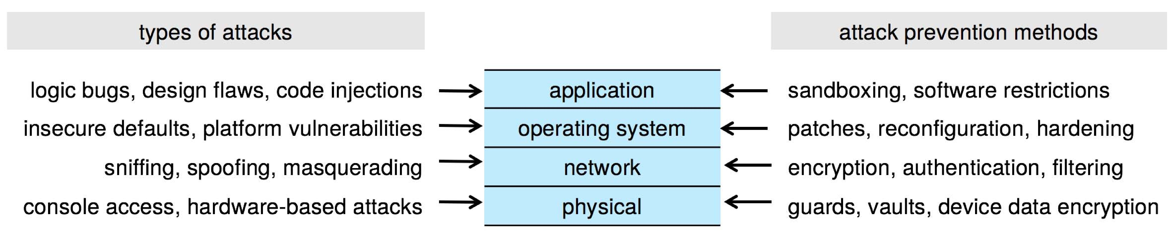
Four-layered Model of Security

Slide 50
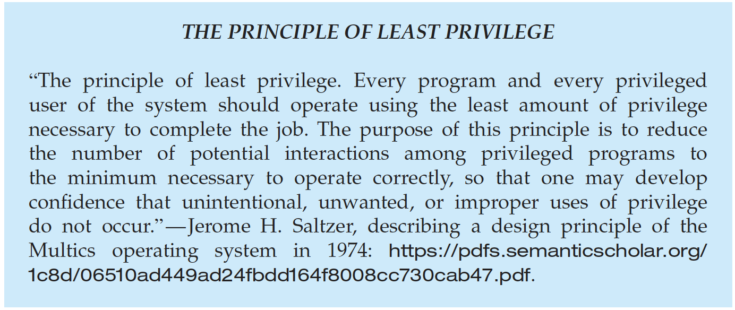
Program Threats (Cont.)
Malware - Software designed to exploit, disable, or damage computer
Trojan Horse – Program that acts in a clandestine manner
Spyware – Program frequently installed with legitimate software to display adds, capture user data
Ransomware – locks up data via encryption, demanding payment to unlock it
Others include trap doors, logic boms
All try to violate the Principle of Least Privilege
Goal frequently is to leave behind Remote Access Tool (RAT) for repeated access

Slide 51
C Program with Buffer-overflow Condition
#include <stdio.h>
#define BUFFER SIZE 256
int main(int argc, char *argv[])
{
char buffer[BUFFER SIZE];
if (argc < 2)
return -1;
else {
strcpy(buffer,argv[1]);
return 0;
}
}
Code review can help – programmers review each other’s code, looking for logic flows, programming flaws

Slide 52
Code Injection
Code-injection attack occurs when system code is not malicious but has bugs allowing executable code to be added or modified
Results from poor or insecure programming paradigms, commonly in low level languages like C or C++ which allow for direct memory access through pointers
Goal is a buffer overflow in which code is placed in a buffer and execution caused by the attack
Can be run by script kiddies – use tools written but exploit identifiers

Slide 53
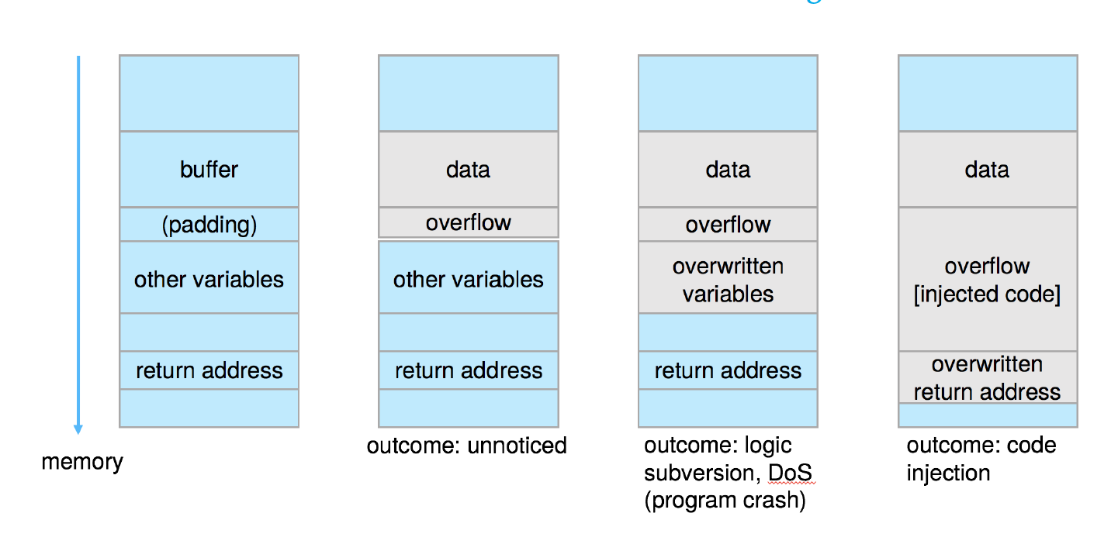
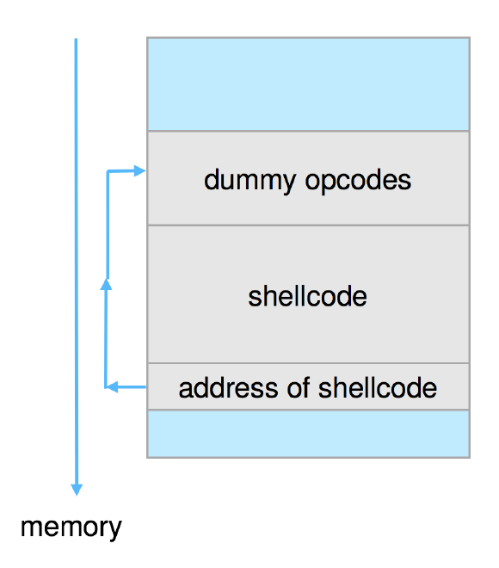
Code Injection (Cont.)
Outcomes from code injection include:
Frequently use trampoline to code execution to exploit buffer overflow:

Slide 54
Great Programming Required?
For the first step of determining the bug, and second step of writing exploit code, yes
Script kiddies can run pre-written exploit code to attack a given system
Attack code can get a shell with the processes’ owner’s permissions
Or open a network port, delete files, download a program, etc.
Depending on bug, attack can be executed across a network using allowed connections, bypassing firewalls
Buffer overflow can be disabled by disabling stack execution or adding bit to page table to indicate “non-executable” state
Available in SPARC and x86
But still have security exploits

Slide 55
Program Threats (Cont.)
Viruses
Code fragment embedded in legitimate program
Self-replicating, designed to infect other computers
Very specific to CPU architecture, operating system, applications
Usually borne via email or as a macro
Visual Basic Macro to reformat hard drive
Sub AutoOpen()
Dim oFS
Set oFS = CreateObject(’’Scripting.FileSystemObject’’)
vs = Shell(’’c:command.com /k format c:’’,vbHide)
End Sub

Slide 56
Program Threats (Cont.)
Virus dropper inserts virus onto the system
Many categories of viruses, literally many thousands of viruses
File / parasitic
Boot / memory
Macro
Source code
Polymorphic to avoid having a virus signature
Encrypted
Stealth
Tunneling
Multipartite
Armored

Slide 57
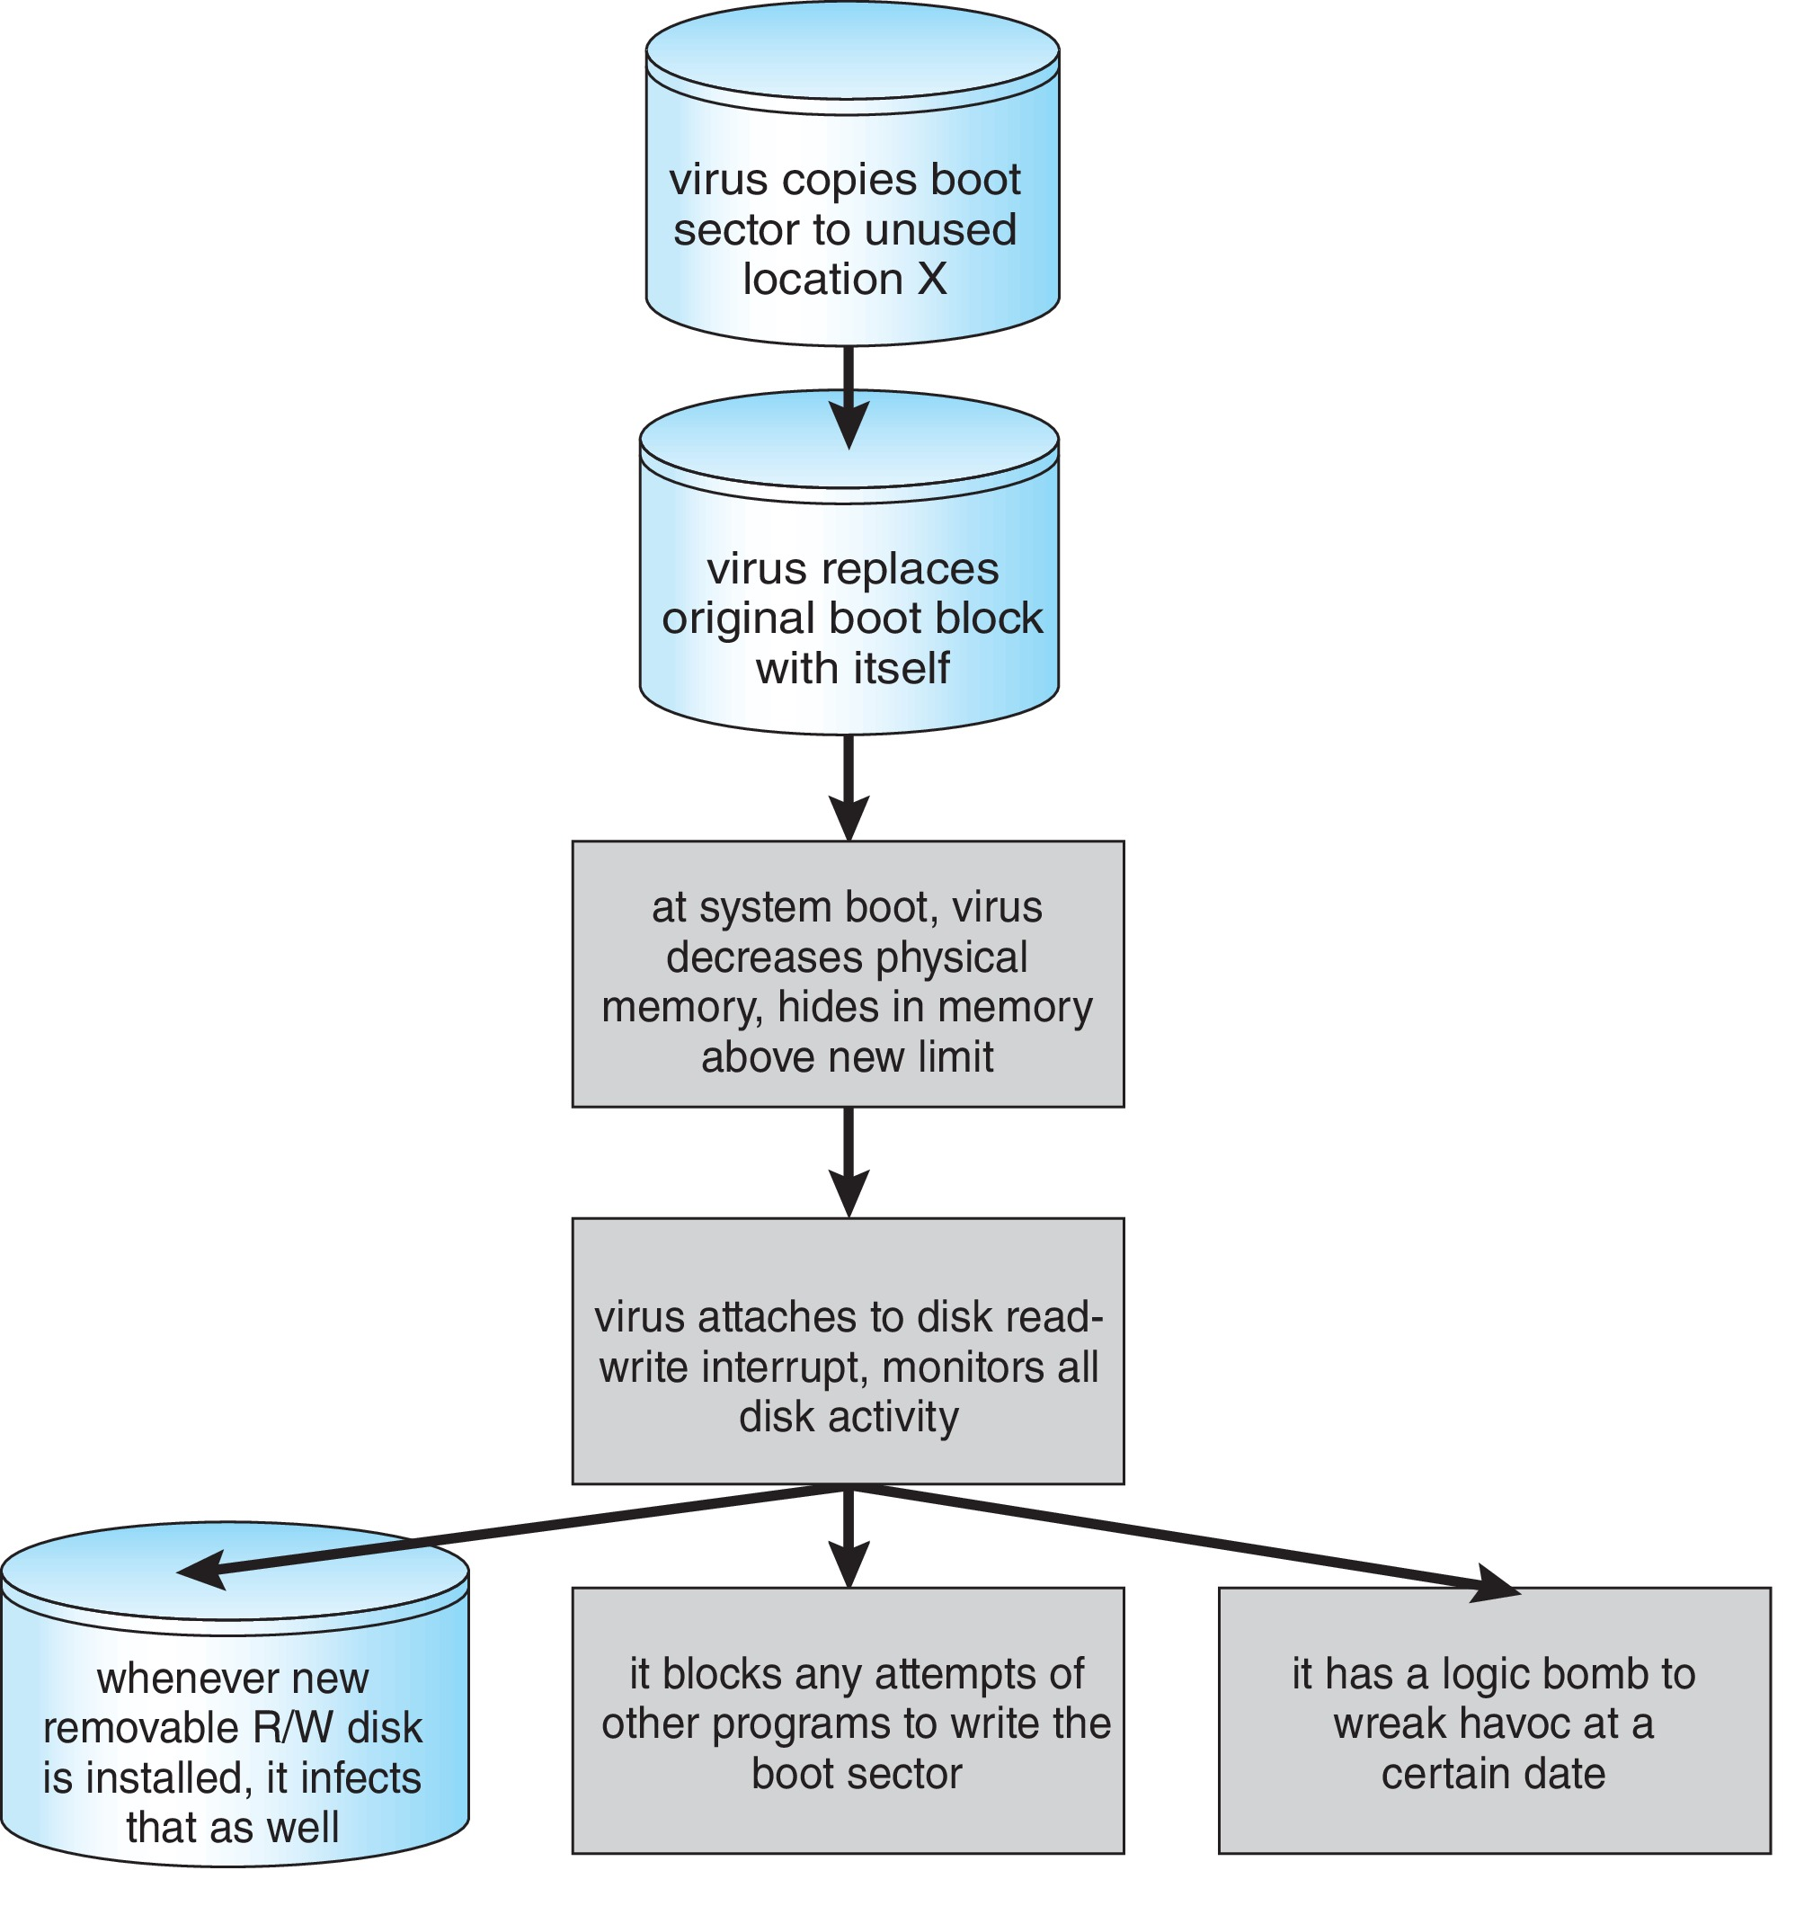
A Boot-sector Computer Virus

Slide 58
The Threat Continues
Attacks still common, still occurring
Attacks moved over time from science experiments to tools of organized crime
Targeting specific companies
Creating botnets to use as tool for spam and DDOS delivery
Keystroke logger to grab passwords, credit card numbers
Why is Windows the target for most attacks?
Most common
Everyone is an administrator
Licensing required?
Monoculture considered harmful

Slide 59
System and Network Threats
Some systems “open” rather than secure by default
Reduce attack surface
But harder to use, more knowledge needed to administer
Network threats harder to detect, prevent
Protection systems weaker
More difficult to have a shared secret on which to base access
No physical limits once system attached to internet
Or on network with system attached to internet
Even determining location of connecting system difficult
IP address is only knowledge

Slide 60
System and Network Threats
Worms – use spawn mechanism; standalone program
Internet worm
Exploited UNIX networking features (remote access) and bugs in finger and sendmail programs
Exploited trust-relationship mechanism used by rsh to access friendly systems without use of password
Grappling hook program uploaded main worm program
99 lines of C code
Hooked system then uploaded main code, tried to attack connected systems
Also tried to break into other users accounts on local system via password guessing
If target system already infected, abort, except for every 7th time

Slide 61
System and Network Threats
Port scanning
Automated attempt to connect to a range of ports on one or a range of IP addresses
Detection of answering service protocol
Detection of OS and version running on system
nmap scans all ports in a given IP range for a response
nessus has a database of protocols and bugs (and exploits) to apply against a system
Frequently launched from zombie systems
To decrease trace-ability

Slide 62
System and Network Threats
Denial of Service
Overload the targeted computer preventing it from doing any useful work
Distributed Denial-of-Service (DDoS) come from multiple sites at once
Consider the start of the IP-connection handshake (SYN)
How many started-connections can the OS handle?
Consider traffic to a web site
How can you tell the difference between being a target and being really popular?
Accidental – CS students writing bad fork() code
Purposeful – extortion, punishment
Port scanning
Automated tool to look for network ports accepting connections
Used for good and evil

Slide 63
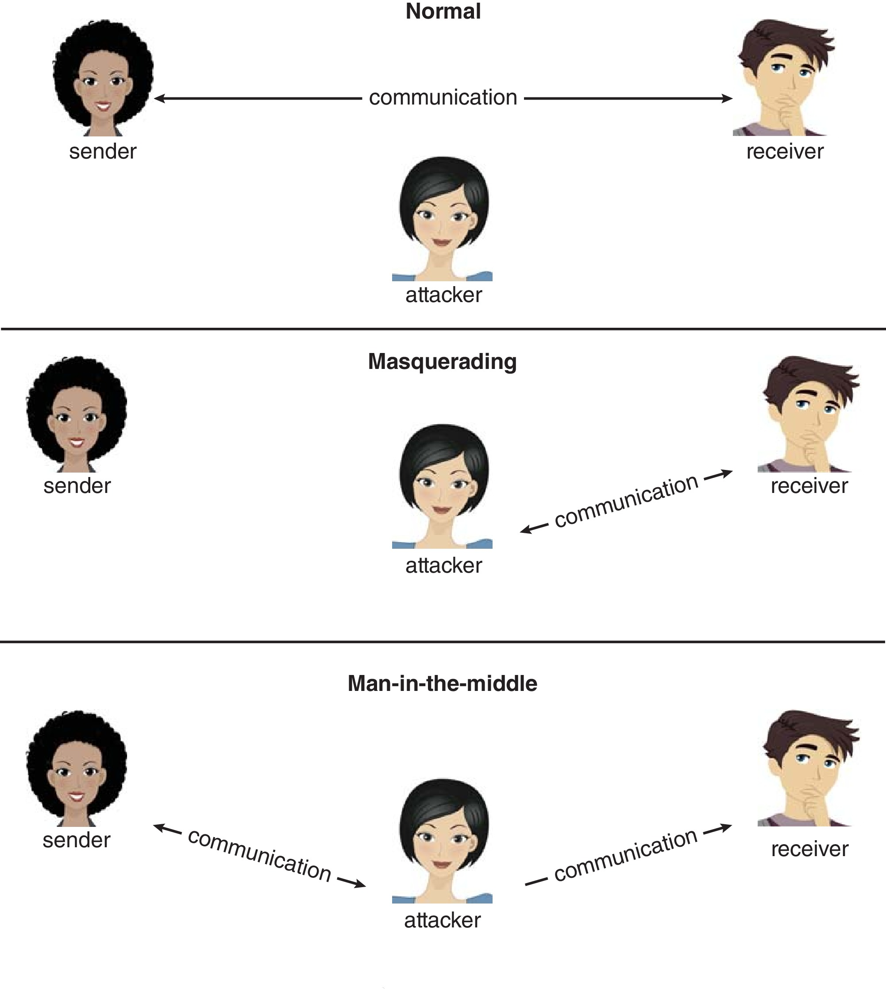
Standard Security Attacks

Slide 64
Cryptography as a Security Tool
Broadest security tool available
Internal to a given computer, source and destination of messages can be known and protected
OS creates, manages, protects process IDs, communication ports
Source and destination of messages on network cannot be trusted without cryptography
Local network – IP address?
Consider unauthorized host added
WAN / Internet – how to establish authenticity
Not via IP address

Slide 65
Cryptography
Means to constrain potential senders (sources) and / or receivers (destinations) of messages
Based on secrets (keys)
Enables
Confirmation of source
Receipt only by certain destination
Trust relationship between sender and receiver

Slide 66
Encryption
Constrains the set of possible receivers of a message
Encryption algorithm consists of
Set K of keys
Set M of Messages
Set C of ciphertexts (encrypted messages)
A function E : K → (M→C). That is, for each k ∈ K, E_{k} is a function for generating ciphertexts from messages
Both E and E_{k} for any k should be efficiently computable functions
A function D : K → (C → M). That is, for each k ∈ K, D_{k} is a function for generating messages from ciphertexts
Both D and D_{k} for any k should be efficiently computable functions

Slide 67
Encryption
An encryption algorithm must provide this essential property: Given a ciphertext c ∈ C, a computer can compute m such that E_{k}(m) = c only if it possesses k
Thus, a computer holding k can decrypt ciphertexts to the plaintexts used to produce them, but a computer not holding k cannot decrypt ciphertexts
Since ciphertexts are generally exposed (for example, sent on the network), it is important that it be infeasible to derive k from the ciphertexts

Slide 68
Symmetric Encryption
Same key used to encrypt and decrypt
Therefore k must be kept secret
DES was most commonly used symmetric block-encryption algorithm (created by US Govt)
Encrypts a block of data at a time
Keys too short so now considered insecure
Triple-DES considered more secure
Algorithm used 3 times using 2 or 3 keys
For example
2001 NIST adopted new block cipher - Advanced Encryption Standard (AES)
Keys of 128, 192, or 256 bits, works on 128 bit blocks
RC4 is most common symmetric stream cipher, but known to have vulnerabilities
Encrypts/decrypts a stream of bytes (i.e., wireless transmission)
Key is a input to pseudo-random-bit generator
Generates an infinite keystream

Slide 69
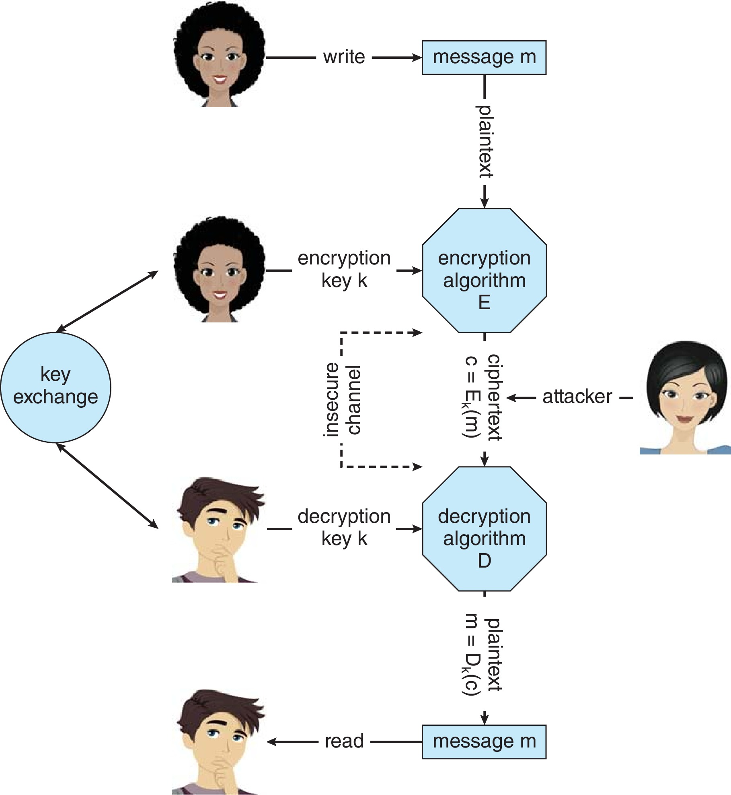
Secure Communication over Insecure Medium

Slide 70
Asymmetric Encryption
Public-key encryption based on each user having two keys:
public key – published key used to encrypt data
private key – key known only to individual user used to decrypt data
Must be an encryption scheme that can be made public without making it easy to figure out the decryption scheme
Most common is RSA block cipher
Efficient algorithm for testing whether or not a number is prime
No efficient algorithm is know for finding the prime factors of a number

Slide 71
Asymmetric Encryption
Formally, it is computationally infeasible to derive k_{d,N} from k_{e,N}, and so k_{e} need not be kept secret and can be widely disseminated
k_{e} is the public key
k_{d} is the private key
N is the product of two large, randomly chosen prime numbers p and q (for example, p and q are 512 bits each)
Encryption algorithm is E_{ke,N}(m) = m^{ke} mod N, where k_{e} satisfies k_{e}k_{d} mod (p−1)(q −1) = 1
The decryption algorithm is then D_{kd,N}(c) = c^{kd} mod N

Slide 72
Asymmetric Encryption Example
For example. make p = 7and q = 13
We then calculate N = 7∗13 = 91 and (p−1)(q−1) = 72
We next select k_{e} relatively prime to 72 and< 72, yielding 5
Finally, we calculate k_{d} such that k_{e}k_{d} mod 72 = 1, yielding 29
We how have our keys
Public key, k_{e,N} = 5, 91
Private key, k_{d,N} = 29, 91
Encrypting the message 69 with the public key results in the cyphertext 62
Cyphertext can be decoded with the private key
Public key can be distributed in cleartext to anyone who wants to communicate with holder of public key

Slide 73
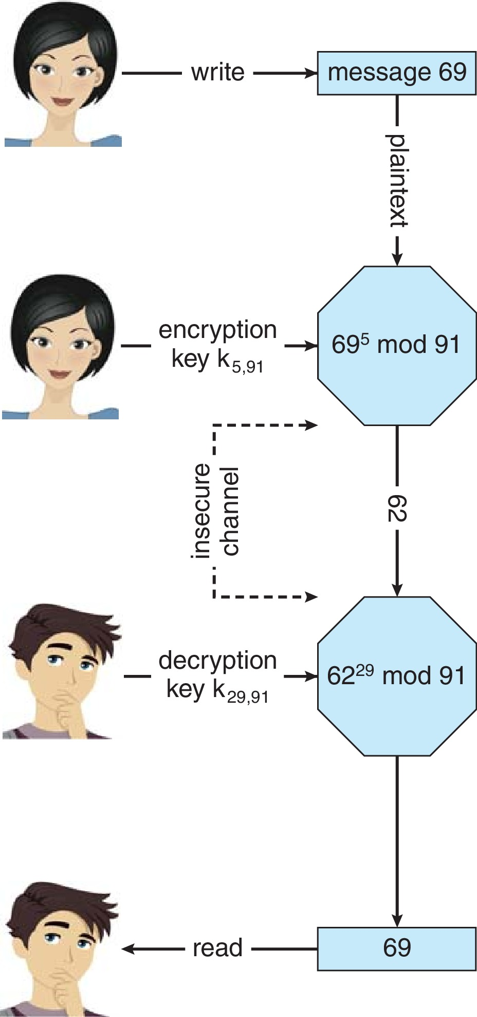
Encryption using RSA Asymmetric Cryptography

Slide 74
Cryptography (Cont.)
Note symmetric cryptography based on transformations, asymmetric based on mathematical functions
Asymmetric much more compute intensive
Typically not used for bulk data encryption

Slide 75
Authentication
Constraining set of potential senders of a message
Complementary to encryption
Also can prove message unmodified
Algorithm components
A set K of keys
A set M of messages
A set A of authenticators
A function S : K → (M→ A)
That is, for each k ∈ K, S_{k} is a function for generating authenticators from messages
Both S and S_{k} for any k should be efficiently computable functions
A function V : K → (M × A→ {true, false}). That is, for each k ∈ K, V_{k} is a function for verifying authenticators on messages
Both V and V_{k} for any k should be efficiently computable functions

Slide 76
Authentication (Cont.)
For a message m, a computer can generate an authenticator a ∈ A such that V_{k}(m, a) = true only if it possesses k
Thus, computer holding k can generate authenticators on messages so that any other computer possessing k can verify them
Computer not holding k cannot generate authenticators on messages that can be verified using V_{k}
Since authenticators are generally exposed (for example, they are sent on the network with the messages themselves), it must not be feasible to derive k from the authenticators
Practically, if V_{k}(m,a) = true then we know m has not been modified and that send of message has k
If we share k with only one entity, know where the message originated

Slide 77
Authentication – Hash Functions
Basis of authentication
Creates small, fixed-size block of data message digest (hash value) from m
Hash Function H must be collision resistant on m
Must be infeasible to find an m’ ≠ m such that H(m) = H(m’)
If H(m) = H(m’), then m = m’
The message has not been modified
Common message-digest functions include MD5, which produces a 128-bit hash, and SHA-1, which outputs a 160-bit hash
Not useful as authenticators
For example H(m) can be sent with a message
But if H is known someone could modify m to m’ and recompute H(m’) and modification not detected
So must authenticate H(m)

Slide 78
Authentication - MAC
Symmetric encryption used in message-authentication code (MAC) authentication algorithm
Cryptographic checksum generated from message using secret key
Can securely authenticate short values
If used to authenticate H(m) for an H that is collision resistant, then obtain a way to securely authenticate long message by hashing them first
Note that k is needed to compute both S_{k} and V_{k}, so anyone able to compute one can compute the other

Slide 79
Authentication – Digital Signature
Based on asymmetric keys and digital signature algorithm
Authenticators produced are digital signatures
Very useful – anyone can verify authenticity of a message
In a digital-signature algorithm, computationally infeasible to derive k_{s} from k_{v}
V is a one-way function
Thus, k_{v} is the public key and k_{s} is the private key
Consider the RSA digital-signature algorithm
Similar to the RSA encryption algorithm, but the key use is reversed
Digital signature of message S_{ks} (m) = H(m)^{ks} mod N
The key k_{s} again is a pair (d, N), where N is the product of two large, randomly chosen prime numbers p and q
Verification algorithm is V_{kv}(m, a) (a^{kv} mod N = H(m))
Where k_{v} satisfies k_{v}k_{s} mod (p − 1)(q − 1) = 1

Slide 80
Authentication (Cont.)
Why authentication if a subset of encryption?
Fewer computations (except for RSA digital signatures)
Authenticator usually shorter than message
Sometimes want authentication but not confidentiality
Signed patches et al
Can be basis for non-repudiation

Slide 81
Key Distribution
Delivery of symmetric key is huge challenge
Sometimes done out-of-band
Asymmetric keys can proliferate – stored on key ring
Even asymmetric key distribution needs care – man-in-the-middle attack

Slide 82
Digital Certificates
Proof of who or what owns a public key
Public key digitally signed a trusted party
Trusted party receives proof of identification from entity and certifies that public key belongs to entity
Certificate authority are trusted party – their public keys included with web browser distributions
They vouch for other authorities via digitally signing their keys, and so on

Slide 83
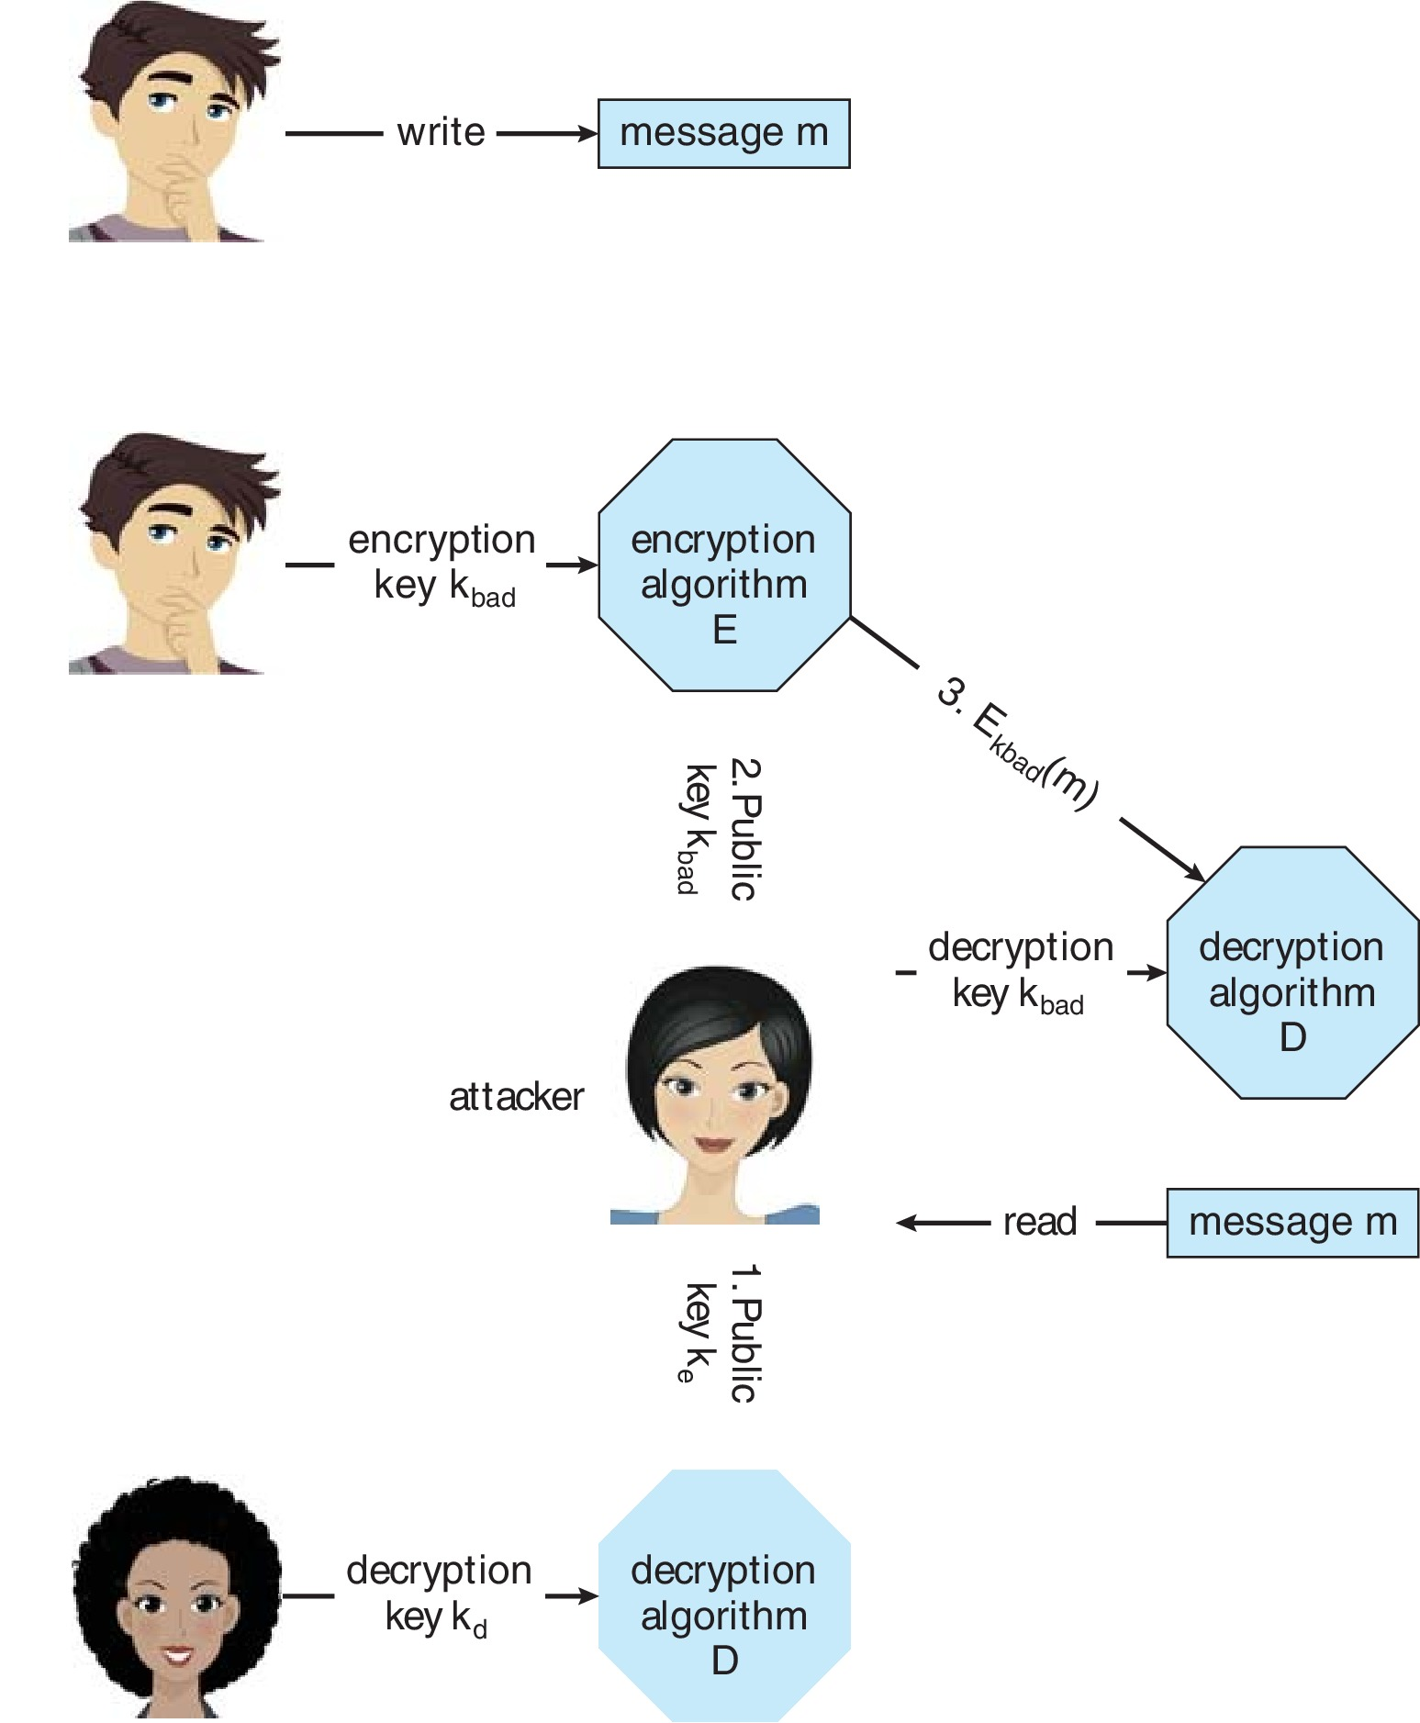
Man-in-the-middle Attack on Asymmetric Cryptography

Slide 84
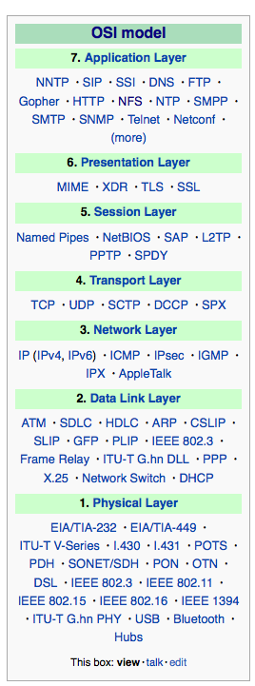
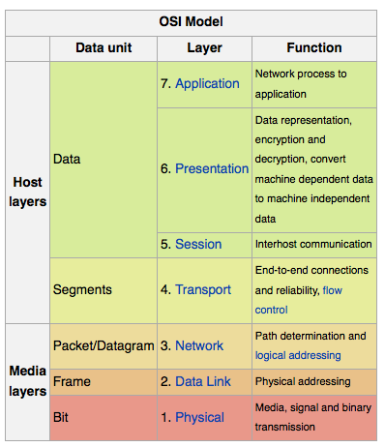
Implementation of Cryptography
Can be done at various layers of ISO Reference Model
SSL at the Transport layer
Network layer is typically IPSec
IKE for key exchange
Basis of Virtual Private Networks (VPNs)
Why not just at lowest level?
Sometimes need more knowledge than available at low levels
i.e., User authentication
i.e., e-mail delivery
Source: http://en.wikipedia.org/wiki/OSI_model

Slide 85
Encryption Example - TLS
Insertion of cryptography at one layer of the ISO network model (the transport layer)
SSL – Secure Socket Layer (also called TLS)
Cryptographic protocol that limits two computers to only exchange messages with each other
Very complicated, with many variations
Used between web servers and browsers for secure communication (credit card numbers)
The server is verified with a certificate assuring client is talking to correct server
Asymmetric cryptography used to establish a secure session key (symmetric encryption) for bulk of communication during session
Communication between each computer then uses symmetric key cryptography
More details in textbook

Slide 86
User Authentication
Crucial to identify user correctly, as protection systems depend on user ID
User identity most often established through passwords, can be considered a special case of either keys or capabilities
Passwords must be kept secret
Frequent change of passwords
History to avoid repeats
Use of “non-guessable” passwords
Log all invalid access attempts (but not the passwords themselves)
Unauthorized transfer
Passwords may also either be encrypted or allowed to be used only once
Does encrypting passwords solve the exposure problem?
Might solve sniffing
Consider shoulder surfing
Consider Trojan horse keystroke logger
How are passwords stored at authenticating site?

Slide 87
Passwords
Encrypt to avoid having to keep secret
But keep secret anyway (i.e. Unix uses superuser-only readably file /etc/shadow)
Use algorithm easy to compute but difficult to invert
Only encrypted password stored, never decrypted
Add “salt” to avoid the same password being encrypted to the same value
One-time passwords
Use a function based on a seed to compute a password, both user and computer
Hardware device / calculator / key fob to generate the password
Changes very frequently
Biometrics
Some physical attribute (fingerprint, hand scan)
Multi-factor authentication
Need two or more factors for authentication
i.e., USB “dongle”, biometric measure, and password

Slide 88
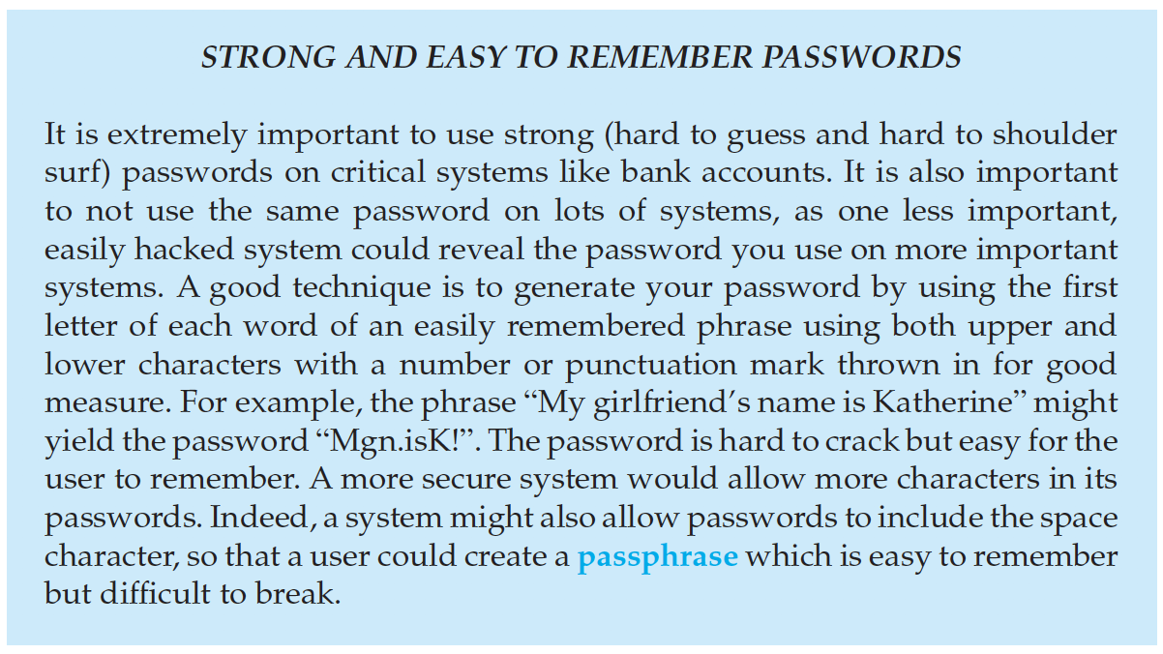
Passwords (Cont.)

Slide 89
Implementing Security Defenses
Defense in depth is most common security theory – multiple layers of security
Security policy describes what is being secured
Vulnerability assessment compares real state of system / network compared to security policy
Intrusion detection endeavors to detect attempted or successful intrusions
Signature-based detection spots known bad patterns
Anomaly detection spots differences from normal behavior
Can detect zero-day attacks
False-positives and false-negatives a problem
Virus protection
Searching all programs or programs at execution for known virus patterns
Or run in sandbox so can’t damage system
Auditing, accounting, and logging of all or specific system or network activities
Practice safe computing – avoid sources of infection, download from only “good” sites, etc

Slide 90
Firewalling to Protect Systems and Networks
A network firewall is placed between trusted and untrusted hosts
The firewall limits network access between these two security domains
Can be tunneled or spoofed
Tunneling allows disallowed protocol to travel within allowed protocol (i.e., telnet inside of HTTP)
Firewall rules typically based on host name or IP address which can be spoofed
Personal firewall is software layer on given host
Can monitor / limit traffic to and from the host
Application proxy firewall understands application protocol and can control them (i.e., SMTP)
System-call firewall monitors all important system calls and apply rules to them (i.e., this program can execute that system call)

Slide 91
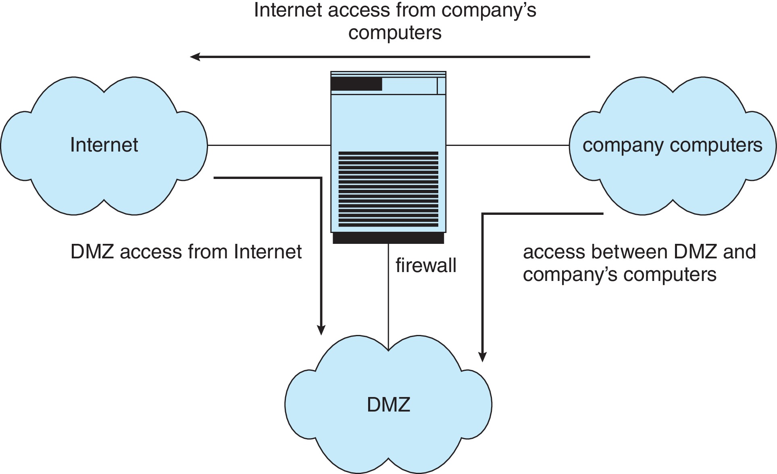
Network Security Through Domain Separation Via Firewall

Slide 92
Computer Security Classifications
U.S. Department of Defense outlines four divisions of computer security: A, B, C, and D
D – Minimal security
C – Provides discretionary protection through auditing
Divided into C1 and C2
C1 identifies cooperating users with the same level of protection
C2 allows user-level access control
B – All the properties of C, however each object may have unique sensitivity labels
Divided into B1, B2, and B3
A – Uses formal design and verification techniques to ensure security

Slide 93
Security Defenses Summarized
By applying appropriate layers of defense, we can keep systems safe from all but the most persistent attackers. In summary, these layers may include the following:
Educate users about safe computing—don’t attach devices of unknown origin to the computer, don’t share passwords, use strong passwords, avoid falling for social engineering appeals, realize that an e-mail is not necessarily a private communication, and so on
Educate users about how to prevent phishing attacks—don’t click on email attachments or links from unknown (or even known) senders; authenticate (for example, via a phone call) that a request is legitimate
Use secure communication when possible
Physically protect computer hardware
Configure the operating system to minimize the attack surface; disable all unused services
Configure system daemons, privileges applications, and services to be as secure as possible

Slide 94
Security Defenses Summarized
Use modern hardware and software, as they are likely to have up-to-date security features
Keep systems and applications up to date and patched
Only run applications from trusted sources (such as those that are code signed)
Enable logging and auditing; review the logs periodically, or automate alerts
Install and use antivirus software on systems susceptible to viruses, and keep the software up to date
Use strong passwords and passphrases, and don’t record them where they could be found
Use intrusion detection, firewalling, and other network-based protection systems as appropriate
For important facilities, use periodic vulnerability assessments and other testing methods to test security and response to incidents

Slide 95
Security Defenses Summarized
Encrypt mass-storage devices, and consider encrypting important individual files as well
Have a security policy for important systems and facilities, and keep it up to date

Slide 96
Example: Windows 10
Security is based on user accounts
Each user has unique security ID
Login to ID creates security access token
Includes security ID for user, for user’s groups, and special privileges
Every process gets copy of token
System checks token to determine if access allowed or denied
Uses a subject model to ensure access security
A subject tracks and manages permissions for each program that a user runs
Each object in Windows has a security attribute defined by a security descriptor
For example, a file has a security descriptor that indicates the access permissions for all users

Slide 97
Example: Windows 7 (Cont.)
Win added mandatory integrity controls – assigns integrity label to each securable object and subject
Subject must have access requested in discretionary access-control list to gain access to object
Security attributes described by security descriptor
Owner ID, group security ID, discretionary access-control list, system access-control list
Objects are either container objects (containing other objects, for example a file system directory) or noncontainer objects
By default an object created in a container inherits permissions from the parent object
Some Win 10 security challenges result from security settings being weak by default, the number of services included in a Win 10 system, and the number of applications typically installed on a Win 10 system

Slide 98
Thank You

